Slide 1

B.Tech Computer Science and Engineering
BCSE 497J – Project-I
ScopePilot – AI Assistant for Microscopy
Ayman Mohammed
23BCE2218
Faculty guide Mr. Justus Raju

Slide 2

Aim and Understanding the Problem
Motivation
Microscopy is central to biology education, yet students often observe specimens without knowing what they are seeing, no real-time guidance, no structured feedback.
Problem
Traditional microscopes are passive instruments; expert interpretation is scarce, expensive, and unavailable during self-paced lab sessions.
Core Question
Can a vision-language model analyze a live microscope field of view and deliver structured, educationally grounded explanations, without replacing the human observer?
Constraint
Solution must work with existing hardware (standard microscope + phone camera), require no specialized equipment.

Slide 3
Objectives
01
02
03
Structured AI Analysis Pipeline
ScopePilot- VLM Evaluation
RAG-Grounded Explanations
Build a mobile-first system that captures a live microscope field of view and returns structured AI analysis (specimen ID, visible structures, biological explanation, uncertainty) via a defined JSON schema.
Design and evaluate a custom rubric-based benchmark to select the most reliable free vision-language model for microscopy tasks before integration.
Implement a RAG pipeline grounded in open biology references (OpenStax Biology 2e, LibreTexts) to produce cited, verifiable explanations rather than unconstrained generation.
04
05
Downstream Educational Features
Human-in-the-Loop Design
Deliver AI specimen chat, quiz generation, and multi-image comparison, all powered entirely by the structured analysis output.
The AI augments the observer and makes no medical diagnostic claims, safe for student-facing deployment throughout.

Slide 4
Abstract, Ideation & Approach
What It Is?
ScopePilot AI attaches a phone camera to a microscope eyepiece, captures the field of view the user sees, and sends it to a vision-language model for structured JSON analysis: specimen ID, visible structures, explanation, and uncertainty.
Alternatives Rejected
Continuous real-time streaming — too costly, high-latency
Free-text LLM output — unparseable for downstream features
Dedicated microscope camera hardware — excludes low-resource labs
Design Choice
Capture-triggered analysis via Gemini API + Pydantic response_schema, structured, deterministic, cost-efficient. Downstream features (AI chat, quiz generation, multi-image comparison) are all powered by structured output.

Slide 5
Literature Survey
Author / Year
Method / Contribution
Dataset / Domain
Key Limitation
Lozano et al., 2024 (µ-Bench, NeurIPS)
Expert-curated VLM benchmark across 24 biomedical tasks (electron, fluorescence, light microscopy)
22–24 biomedical microscopy tasks
Current VLMs struggle even on basic modality-distinction tasks; specialist models often underperform generalists
Li et al., 2023 (LLaVA-Med, NeurIPS)
Curriculum fine-tuning of a general VLM on PubMed figure-caption pairs for biomedical visual Q&A
PubMed Central biomedical figures
Requires large-scale GPU training; not deployable in real-time mobile/edge settings
Bai et al., 2024 (Hallucination Survey, arXiv)
Comprehensive taxonomy of hallucination causes, benchmarks, and mitigation strategies in MLLMs
Multiple MLLM benchmarks
Hallucination remains an open problem; no universal mitigation; high-stakes domains especially at risk
Manathunga & Illangasekara, 2023 (RAG in Medical Education, arXiv)
RAG + representative vector summarization applied to LLMs for medical education Q&A
Medical education textbooks
Evaluated on text-only queries; multimodal (image + text) RAG pipelines not addressed
Wang et al., 2024 (BioRAG, arXiv)
RAG-LLM framework over 22M biology papers with domain-specific embedding model and iterative retrieval
22M scientific biology papers
Focused on research-level queries; not designed for real-time student-facing educational use
Burgess et al., 2025 (MicroVQA, PMC)
VQA benchmark for research-level microscopy reasoning: image understanding, hypothesis generation, experiment proposal
1,042 expert-curated MCQs across microscopy modalities
Peak MLLM accuracy only 53%; multimodal reasoning harder than language reasoning alone

Slide 6
Existing Systems vs ScopePilot AI
Feature
General VLMs
(GPT-4V, Gemini)
Specialist Tools
(ImageJ, CellProfiler)
LLaVA-Med
ScopePilot AI
(Proposed)
Live microscope integration
✗
✗
✗
✓ (phone on eyepiece)
Structured JSON output
✗
Partial
✗
✓ (Pydantic schema)
RAG-grounded explanations
✗
✗
✗
✓ (Chroma + OpenStax)
Uncertainty / hallucination guard
Partial
N/A
Partial
✓ (explicit uncertainty field)
Quiz / learning generation
✗
✗
✗
✓
No specialist hardware needed
✓
✗
✓
✓
Open-source / low-cost
✗
✓
Partial
✓

Slide 7
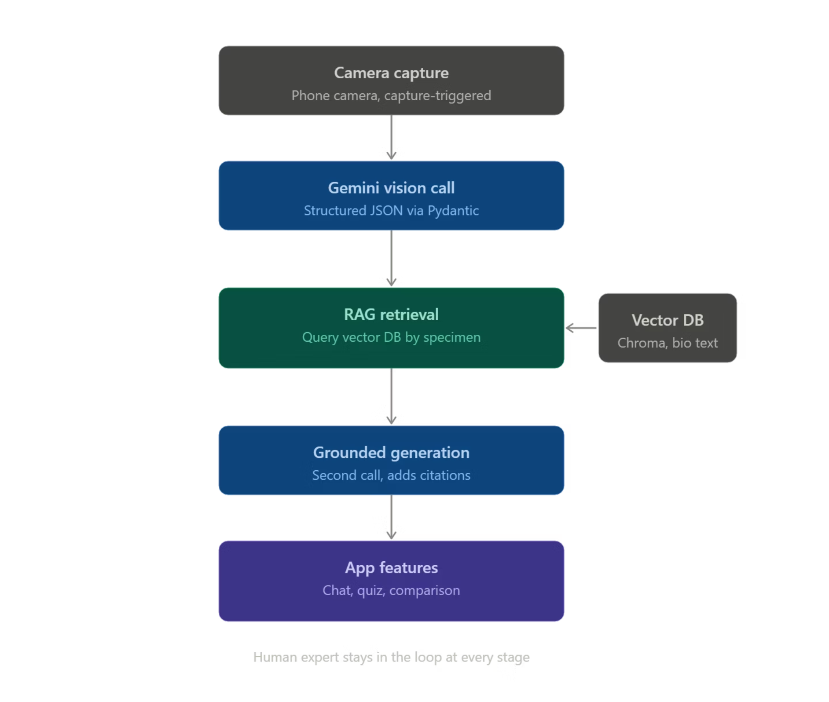
System Pipeline

Slide 8
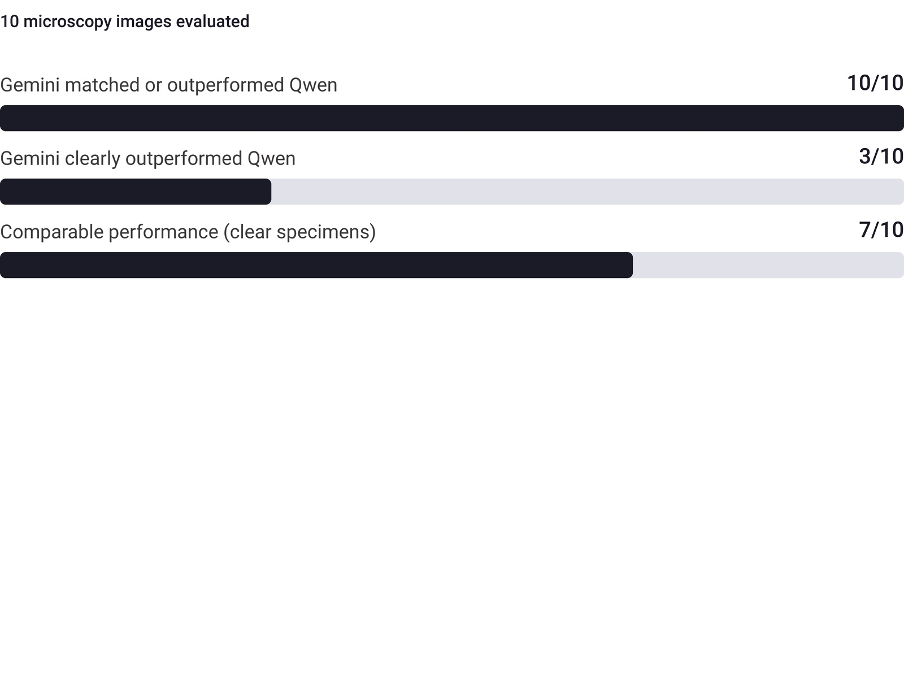

Why Gemini?
Method
Compared both models on 10 real microscope images using a 7-point checklist (correct ID, structures, accuracy, reasoning, hallucinations, explanation quality, confidence). One person scored it — this is a rough comparison, not a formal benchmark.
Result
Both models performed comparably on clear, well-lit specimens. Gemini's advantage appeared specifically on ambiguous or low-quality images, where Qwen tended to hallucinate.
Critical Failure - Qwen
Misidentified an unstained blood wet-mount as "yeast cells"; labeled a visible white blood cell as a platelet while explicitly denying any leukocyte was present.
Both models tied on well-lit, unambiguous specimens. Gemini's advantage is robustness on edge cases, not average performance.

Slide 9




Technical Stack
Frontend
Backend
FastAPI (Python)
REST API · Pipeline orchestration
React Native / Expo
Camera Module
TypeScript · Cross-platform mobile
Capture trigger · Eyepiece attachment
Gemini Vision API
gemini-2.5-flash · Structured JSON analysis
ChromaDB
App UI
Vector store · OpenStax Biology 2e + LibreTexts
Chat interface · Quiz renderer · Comparison view
Gemini Embeddings API
text-embedding-004 · RAG retrieval
Frontend communicates with Backend via a bidirectional REST API — camera captures on device, all AI processing runs server-side.

Slide 10

Sustainable Development Goal Alignment
SDG 4 – Quality Education
Real-time AI explanations transform passive observation into active learning
Structured quiz generation reinforces biological concepts immediately after capture
Accessible to all students regardless of lab resources or expertise level
Affordable deployment using standard microscopes and smartphones, no specialized hardware
Democratizes expert-level microscopy interpretation in under-resourced educational settings

Slide 11
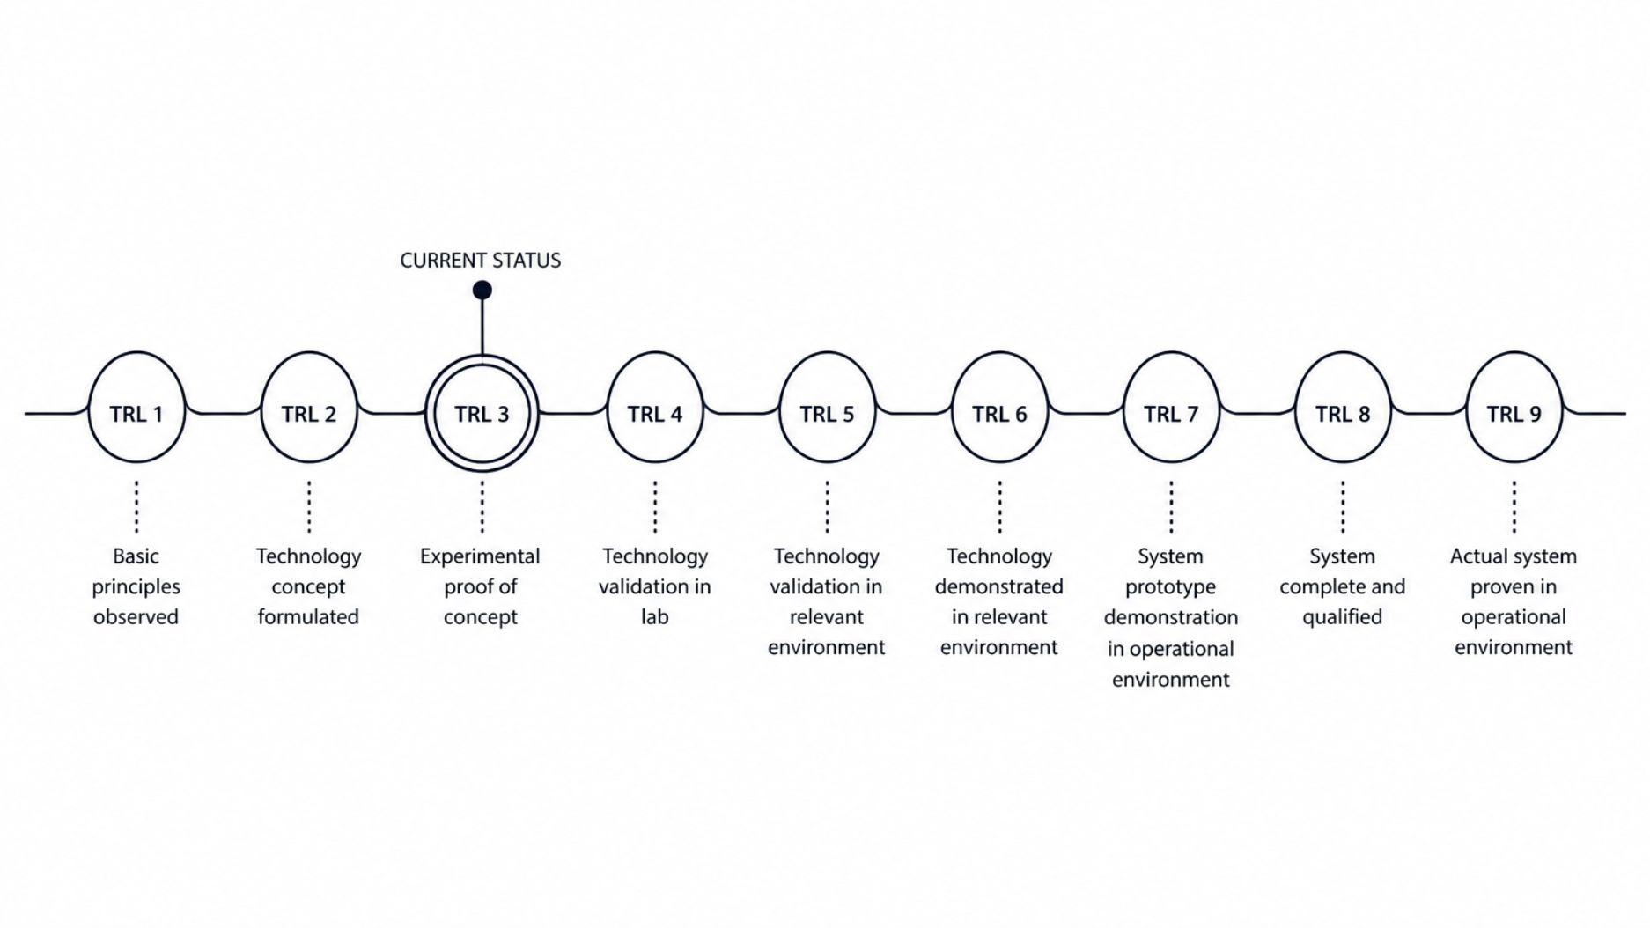


Technology Readiness Level
Current Status (TRL 2 ):
Literature review completed (6 peer-reviewed papers analyzed)
Dataset collection: 10 real microscopy images with expert annotations
Model benchmarking: Gemini 3.5 Flash vs. Qwen 3.7 VL (System architecture designed and validated
Technology stack selected (React Native, FastAPI, Gemini API, Quadr)
Roadmap to TRL 3 (Experimental Proof of Concept):
Expo prototype development with camera integration
Gemini API integration and structured JSON schema validation
RAG pipeline implementation with OpenStax Biology 2e + LibreTexts

Slide 12
Advantages & Applications
Biology Education
Low-Resource Labs
Self-Paced & Asynchronous Learning
Responsible AI Design
Instant structured feedback during lab sessions — students learn what they are observing, not just that they are observing it. Quiz generation reinforces concepts immediately after capture.
Requires only a standard microscope and a smartphone — no dedicated digital microscope, no institutional software license, no internet-connected lab PC.
Nno medical diagnosis framing, human always in the loop — safe for student-facing deployment.
Captured images and AI explanations persist; students can revisit, compare specimens, and continue learning outside lab hours.

Slide 13
References
Lozano, A., Nirschl, J., Burgess, J., et al. (2024). µ-Bench: A Vision-Language Benchmark for Microscopy Understanding. NeurIPS 2024 Datasets & Benchmarks Track.
Li, C., Wong, C., Zhang, S., et al. (2023). LLaVA-Med: Training a Large Language-and-Vision Assistant for Biomedicine in One Day. NeurIPS 2023.
Bai, Z., Wang, P., Xiao, T., et al. (2024). Hallucination of Multimodal Large Language Models: A Survey. arXiv:2404.18930.
Manathunga, S., & Illangasekara, Y. A. (2023). Retrieval Augmented Generation and Representative Vector Summarization for Large Unstructured Textual Data in Medical Education. arXiv:2308.00479.
Wang, C., Long, Q., Xiao, M., et al. (2024). BioRAG: A RAG-LLM Framework for Biological Question Reasoning. arXiv:2408.01107.
Burgess, J., Nirschl, J., Bravo-Sánchez, L., et al. (2025). MicroVQA: A Multimodal Reasoning Benchmark for Microscopy-Based Scientific Research. arXiv:2503.13399.

